Slide 1
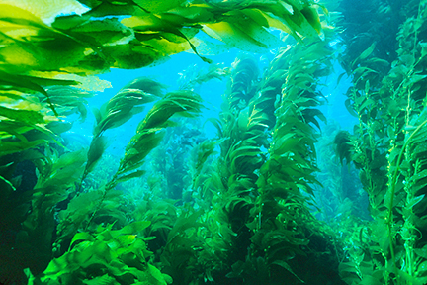
KELP FOREST
divephototguide.com
Damien Cie – UCSD/SIO
Jennifer Ogo – Lincoln HS
uwphotographyguide.com
Notes:
Kelp forests are large underwater forest composed mainly of the large kelp Macrocystis pyrifera. They are known as one of the most diverse and productive ecosystems on earth, providing a refuge and food to numerous organisms from the largest baleen whales to the smallest phytoplankton. Material collected from kelp, known as carrageenan, is found in everything from ice cream to rubber used in tires and gunpowder for bullets. These forests also act as a nursery ground for fish, many of which regulate grazers within the forest allow it to continuously thrive. Kelp forests go through seasonal changes, sloughing or breaking apart due to increased water temperatures and growing at rates of 30cm/day during periods of high nutrients. Human related effects such as water pollution and overfishing can play a large role in the health of theses ecosystems. The latter causing grazing fish to be removed which then allows kelp predators to graze down the forests.

Slide 2
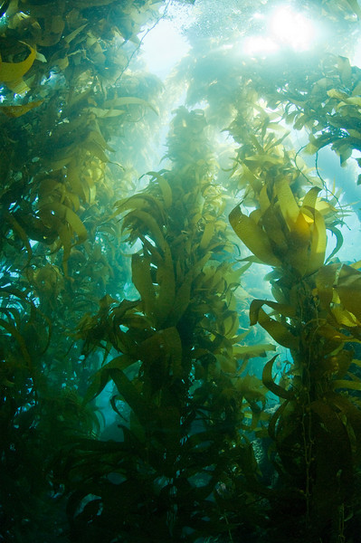
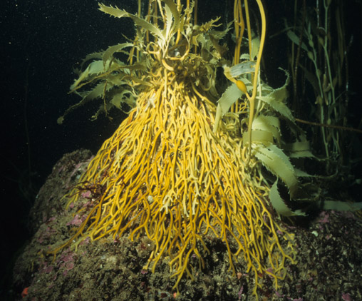
KELP FOREST
Holdfast
uwphotographyguide.com
falklands-underwater.com
Notes:
This lesson is intended to show you how truly diverse kelp forests are.
Activity: Students will be placed into groups and provided with a dissection tool kit and one tray of kelp holdfast material. Using the provided dissection kit, students will cut, tear apart, and sift through the holdfast recording any findings. Findings can consist of anything the student finds interesting (e.g. seastars, bryozoans, kelp blade, worms, holdfast root, etc.).
Notes: The image on the left shows an entire kelp plant rising up through the water column. Kelps are very similar to terrestrial plants collecting energy and food through photosynthesis, which occurs through its entire structure from its blades (leaves) to its stipe (trunk). Kelp forest are known to grow up to 30cm a day during peak periods of high nutrients and light.
The image on the right shows a holdfast or root-like structure of a kelp plant. This structure grows and attaches around large objects, such as rocks, allowing the plant to secure itself to the bottom. Holdfast provide refuge to hundreds of organisms, many of which you will see during your dissection today.

Slide 3
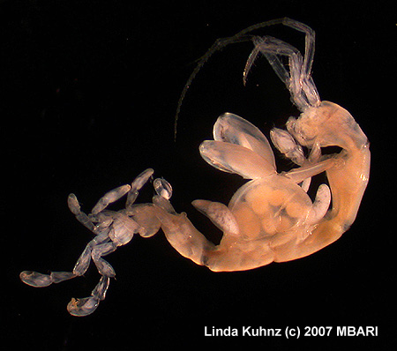
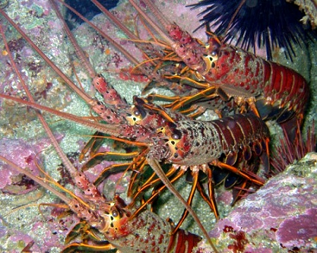
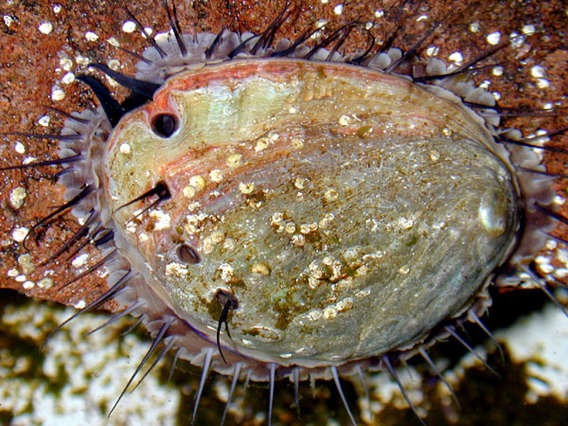
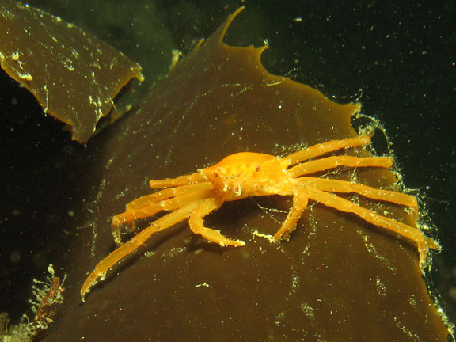
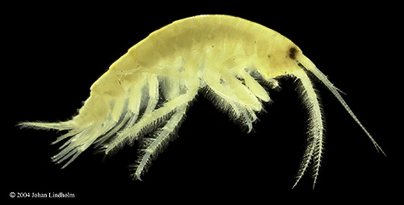
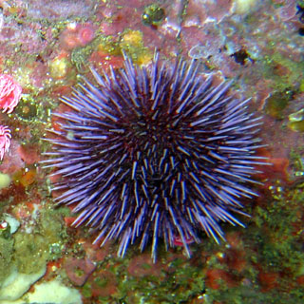
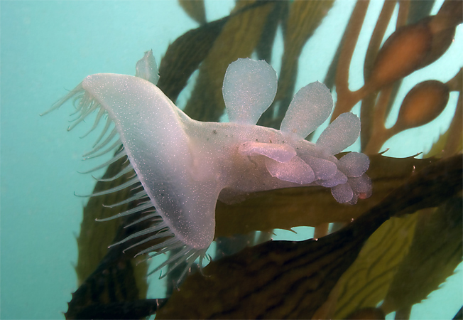
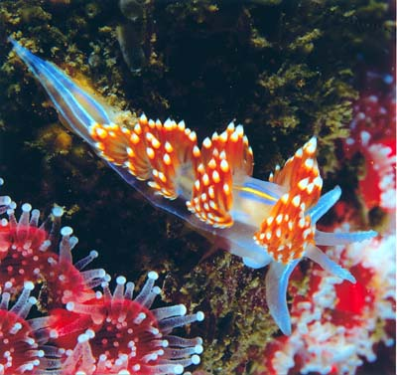
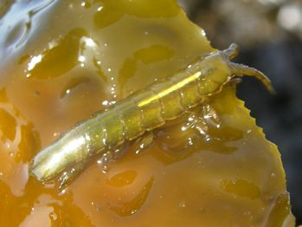
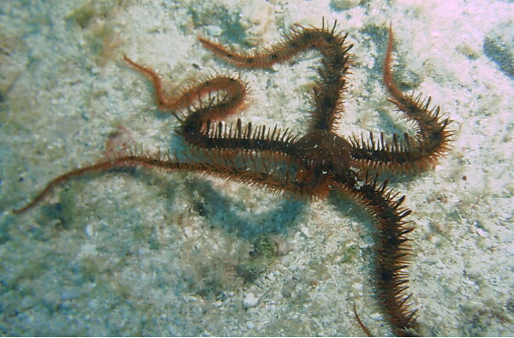
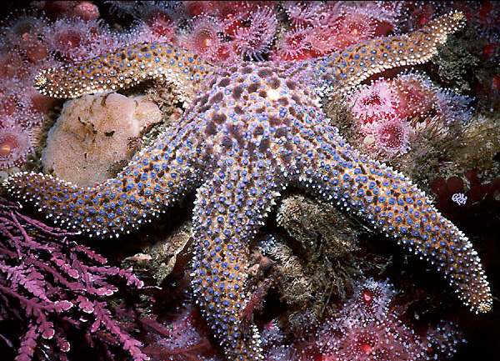
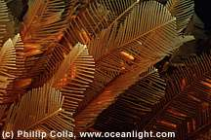
HOME SWEET HOME
malibudivers.com
unigoop.com
mbari.org
mbari.org
divebums.com
coldwaterimages.com
animalpictures.com
aquaticsworlduk.com
nathistoc.bio.uci.edu
deriela.ca
funscubadiver.com
coastalca.gov
wikipedia.com
Notes:
Activity: Kelp holdfast dissection
Notes: Here are some organisms you may find during your dissection (in order of appearance).
1) Lobster
2) Sea star
3) Brittle star
4) Abalone
5) Urchin
6) Melibe
7) Nudibranch
8) Crab
9) Bryozoan
10) Isopod
12) Caprellid
13) Gammarid

Slide 4
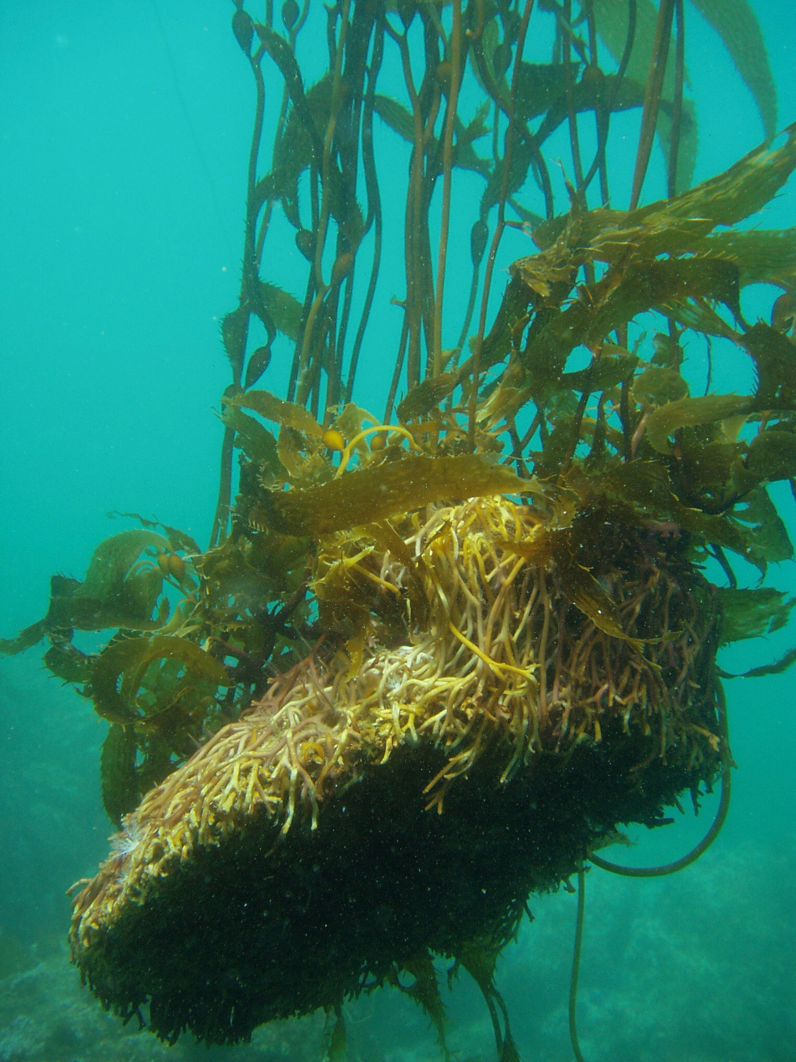
KELP PADDY
Claire Fackler, NOAA National Marine Sanctuaries

